Slide 1
Reinforcement Learning
Understanding Machine Learning
October 2022
Felix Wick

Slide 2
Sequential Decision Making
reinforcement learning (RL):
formalization of sequential decision making of software agent interacting with environment

Slide 3
Main Elements of RL
goal: find action policy maximizing reward from environment
action policy: exploration-exploitation trade-off
e.g., epsilon-greedy: random exploration at small fraction of the time
off-policy instead of on-policy learning: policy for learning different from current best → exploit in application and explore during learning
feedback from environment: goal-directed, no supervision
scalar reward signal
cumulative and delayed rewards (credit assignment problem)

Slide 4
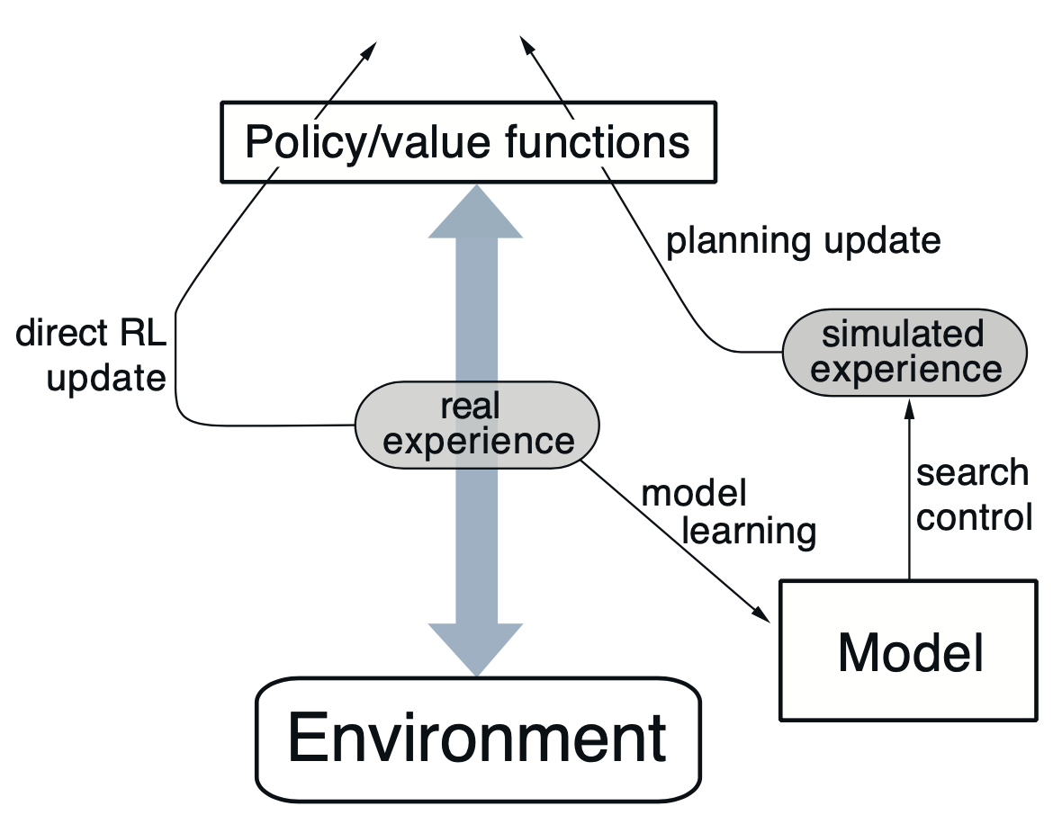
Optional Elements of RL
model of environment: (model-free) trial-and-error or planning
value functions for states or actions: improve efficiency of search in vast action policy space (alternative: direct policy search)

Slide 5
Markov Decision Process (MDP)
idea: current state includes all information about past
transition probabilities between states describe dynamics of given MDP
action policy: mapping from states to probabilities for selection of different actions

Slide 6

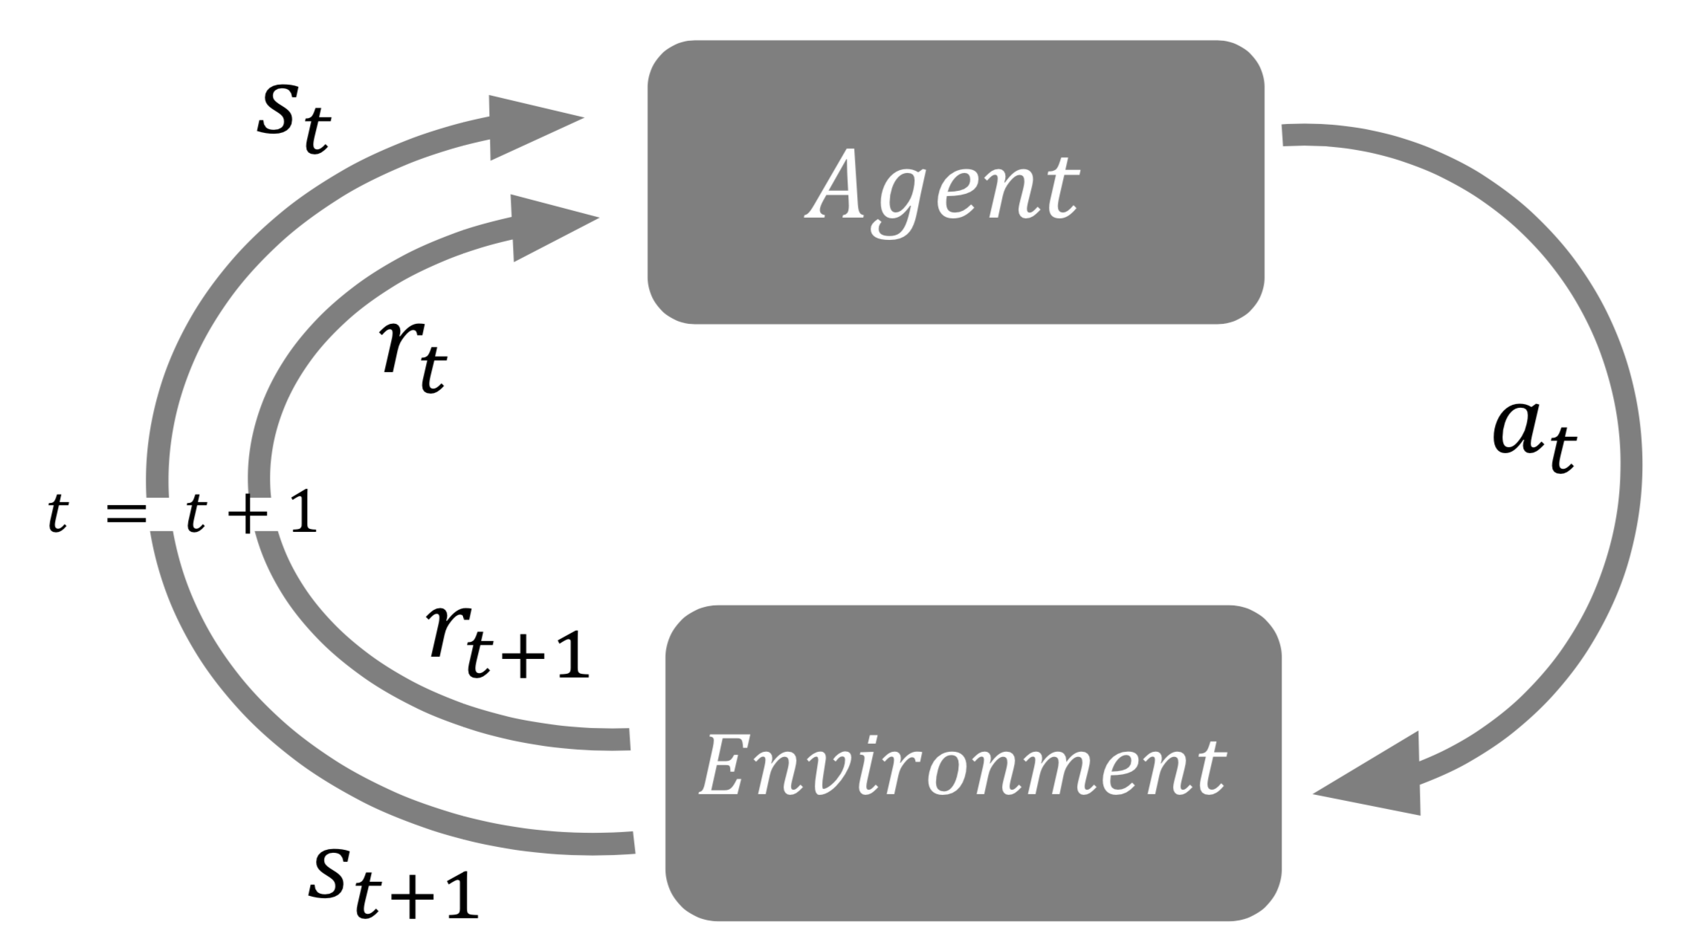
Abstraction: States and Rewards
transition probabilities (model of environment):
reward hypothesis:
reward as scalar signal
goal: maximization of expected cumulative sum of received rewards

Slide 7
Value-Based Methods

Slide 8
State and Action Values
state/action value:
total amount of expected future reward starting from given state or action (usually with discounting of later steps)
→ indicating long-term desirability of states
main motivation: improve efficiency of search in policy space
(for comparison: evolutionary methods search directly by evaluating entire policies)

Slide 9
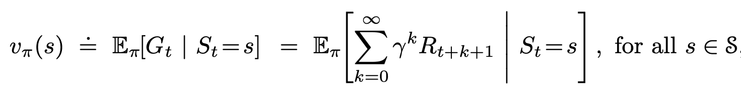
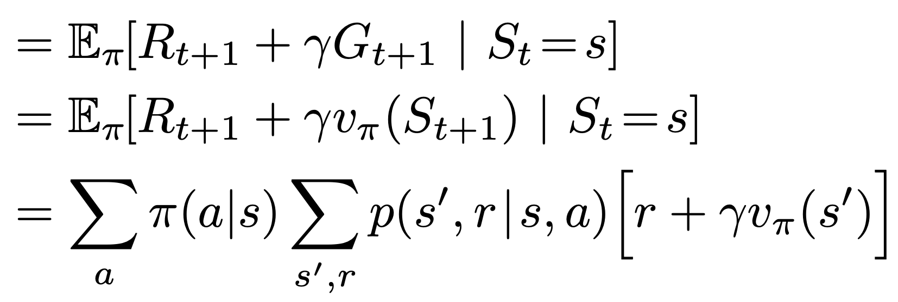
State-Value Function
return
discount rate
policy
Bellman (expectation) equation: recursion
policy: probabilitiy to take action a being in state s
transition probability (depending on environment) from state s to state s’ taking action a

Slide 10
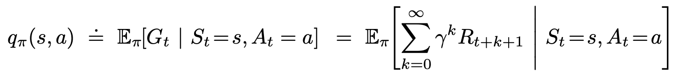
Action-Value Function
state-value function:
action-value function:

Slide 11
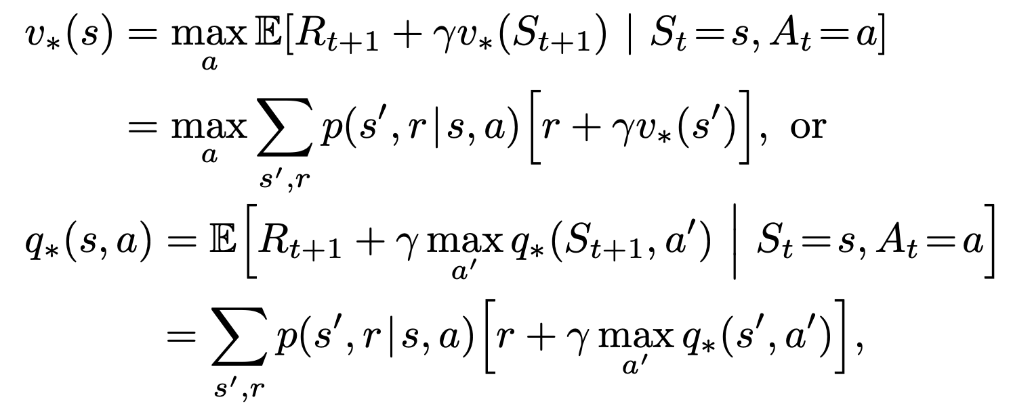
Bellman Optimality Equations
optimal solutions:
rarely possible to find in practice (model of environment, Markov property, computational resources)
→ approximate solutions

Slide 12



Bootstrapping and Sampling
bootstrapping: update estimates of state values based on estimates of values of successor states
sampling: experience of sample sequences (no need for complete knowledge of environment)
Dynamic Programming (DP)
Temporal Difference (TD) Learning
Monte Carlo (MC)
bootstrapping
no sampling
→ model-based (transition probabilities needed)
bootstrapping
sampling
→ model-free
no bootstrapping
sampling
→ model-free

Slide 13
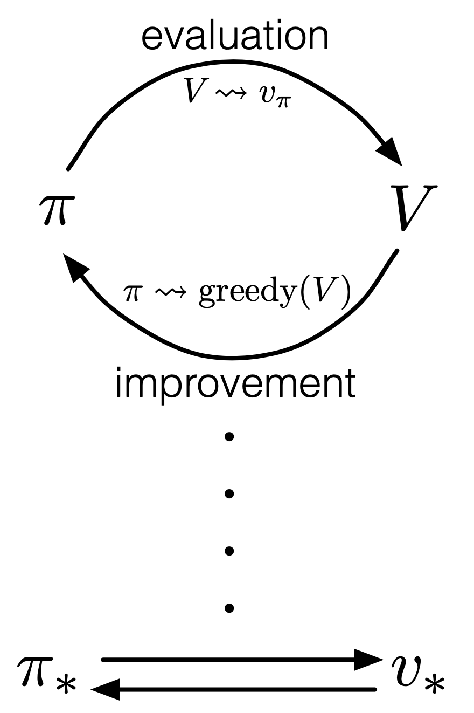
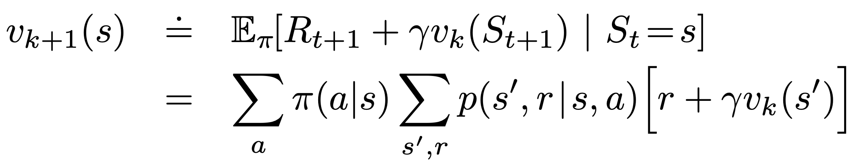

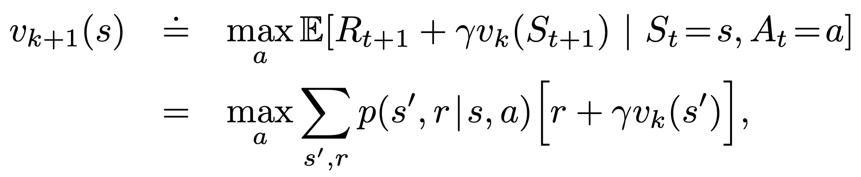
Generalized Policy Iteration (Dynamic Programming)
continuous mutual improvement:
approximate policy and value function
iterative policy evaluation (prediction) of value function with current policy (by means of Bellman expectation equation) by update rule:
policy improvement (control) by adjusting policy to act greedy with respect to value function of current policy
policy iteration:
value iteration (combination of policy improvement and evaluation steps):
→ update rule according to Bellman optimality equation

Slide 14

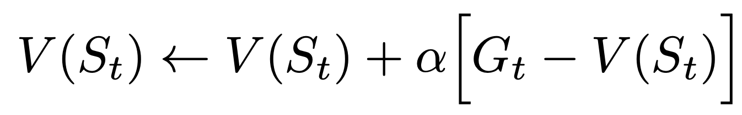
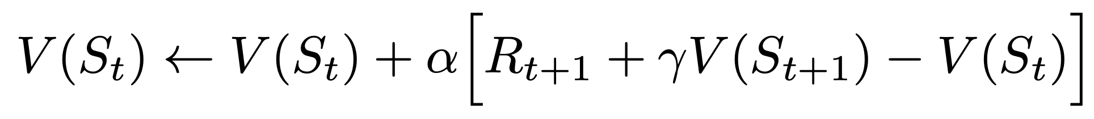
Update Rule
MC:
TD:

Slide 15



On-Policy TD Control: SARSA
generalized policy iteration:
estimating action-value function Q for current behavior policy π
change policy toward greediness with respect to Q (exploration for example via epsilon-greedy policy)
update:
S A R S A

Slide 16

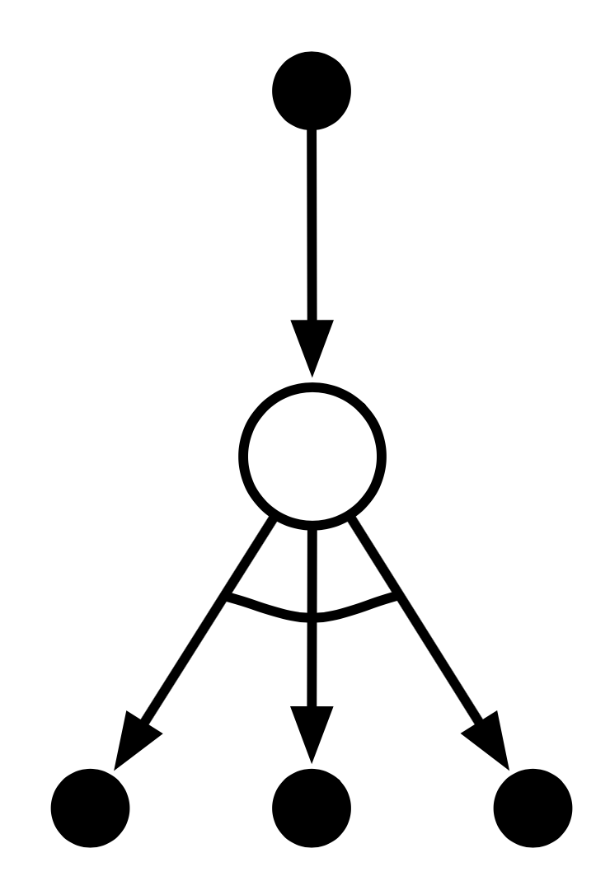

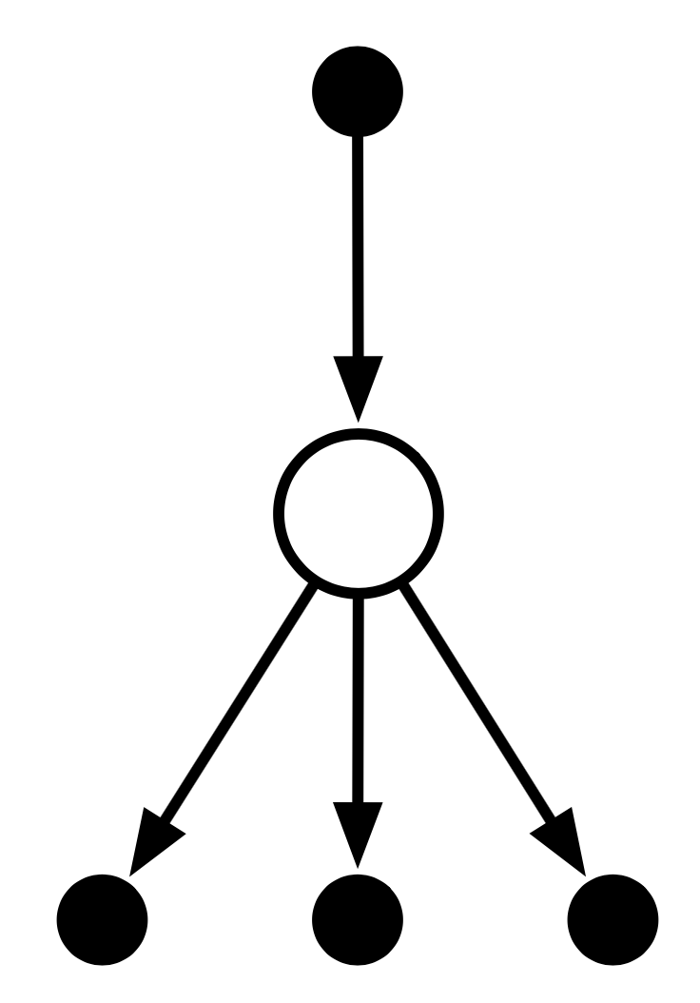

Off-Policy TD Control: Q-Learning
estimate action-value function Q directly approximating optimal action-value function (independent of policy being followed → potentially off-policy)
policy just determines which state-action pairs are visited and updated
update:
expected Sarsa:

Slide 17

Summary: Update Characteristics
one-step TD
reduce depth of search by bootstrapping with value function predicting future outcome
n-step TD
MC
reduce breadth of search by sampling actions from policy

Slide 18
Deep Reinforcement Learning

Slide 19
Limitation of Tabular Methods
tabular methods simply memorize observed data
problem with tabular solution methods in practice: large state/action spaces → curse of dimensionality
need for generalization: supervised learning to the rescue
non-linear function approximation
nowadays often deep learning methods → deep reinforcement learning

Slide 20
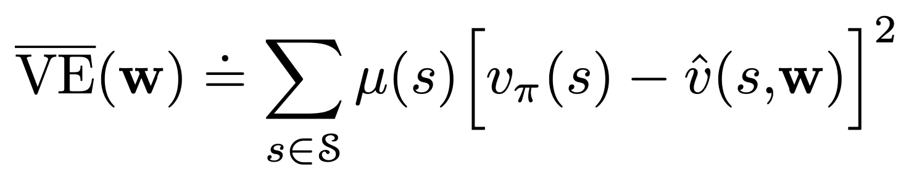
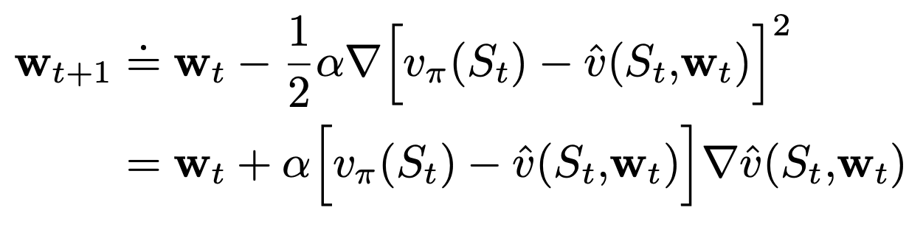
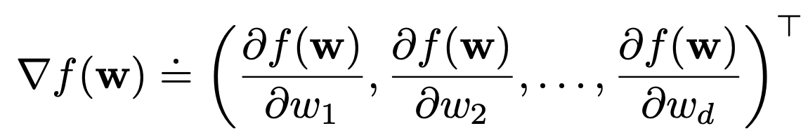
Approximate Solution Methods
value-function as parametrized functional form of state s with weight vector w (instead of table)
w contains parameters for different features describing s (e.g., connection weights in neural network)
objective function
(mean squared value error):
𝝁: state distribution
(e.g., fraction of time spent in s)
stochastic gradient descent:
with

Slide 21
Deep Q-Network (DQN)
deep neural network to approximate Q-function (Q-value as output for any state-action pair)
Mnih et al. (Google DeepMind): Human-level control through deep reinforcement learning
separate target network (weights only periodically updated with Q-network weights)
→ reducing correlations of Q-network with target
experience replay: apply Q-learning updates on samples/minibatches of experience drawn at random from pool of stored samples (agent’s experiences at each time-step)
→ removing correlations in observation sequence (make it i.i.d.)

Slide 22
Side Note: …
… i.i.d. as fundamental assumption of ML
… i.i.d. → causality

Slide 23
Famous Example of Deep RL: AlphaGo
Monte Carlo tree search (heuristic search algorithm) for move (action) selection
guided by deep convolutional neural networks for both value function and policy estimation
→ improving search efficiency
reduce depth of search tree by evaluating positions with value function (predicting outcome from given position → bootstrapping)
reduce breath of search tree by sampling actions using policy network (probability distribution over possible moves in given position)

Slide 24
Side Note: Model-Predictive Control
… beam-search-based planning conceptually an instance of model-predictive control

Slide 25
Direct Policy Search

Slide 26

Policy Gradient Methods
learning of parametrized policy (without value functions):
parameters: e.g., neural network weights
maximizing objective J(𝜽) (expected cumulative rewards)
update rule of REINFORCE method:
policy gradients 𝛻𝜋:
e.g., neural network gradients
𝜽_{t+1} = 𝜽_{t} + 𝛼 ∙ 𝛻(log 𝜋(A_{t}|S_{t}, 𝜽)) ∙ G_{t}
𝛻J(𝜽)
“weighting” with return

Slide 27
Actor-Critic Methods
hybrid between policy-based and value-based methods (to reduce variance)
value function as critic of policy (instead of return):
𝜽_{t+1} = 𝜽_{t} + 𝛼 ∙ 𝛻(log 𝜋(A_{t}|S_{t}, 𝜽)) ∙ Q(S_{t}, A_{t})
independent parametrizations for 𝜋 and Q (e.g., two separate neural networks)
advantage actor-critic: Q(S_{t}, A_{t}) → A(S_{t}, A_{t}) = Q(S_{t}, A_{t}) – V(S_{t})
can be approximated by TD error

Slide 28
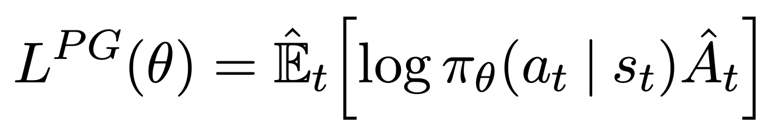
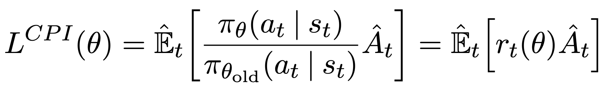
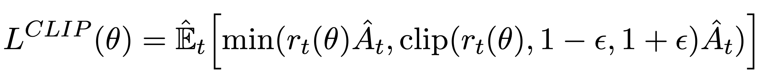
Proximal Policy Optimization (PPO)
arXiv:1707.06347 (OpenAI)
advantage function:
A(s, a) = Q(s, a) – V(s)
policy gradient
state-of-the-art policy gradient method
advantage actor-critic method with clipped surrogate objective function
surrogate objective from trust region policy optimization → better efficiency
clipping: limiting policy update at each training step → improved stability of actor
objective
surrogate
conservative policy iteration
trust-region methods: first choose size of trust region, then direction
line-search methods: first choose direction, then step size

Slide 29
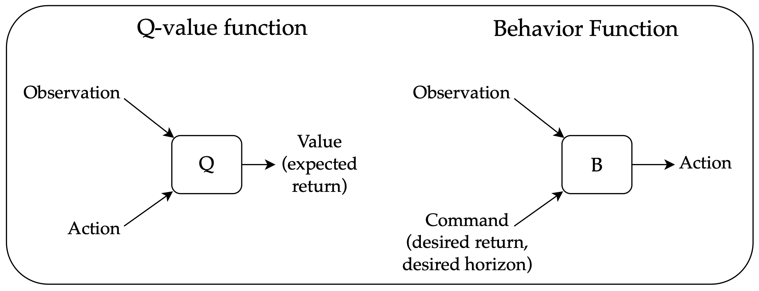
Upside-Down RL
Upside-Down RL, Decision Transformer, Trajectory Transformer
combintion of off-policy bootstrapping (e.g., Q-learning) with high-dimensional function approximation leads to non-stationary targets (deadly triad)
most popular technique to overcome this: target networks (a copy of an agent’s value function is frozen and stored periodically to provide stationary learning targets for temporal-difference learning)
upside –down RL as alternative

Slide 30
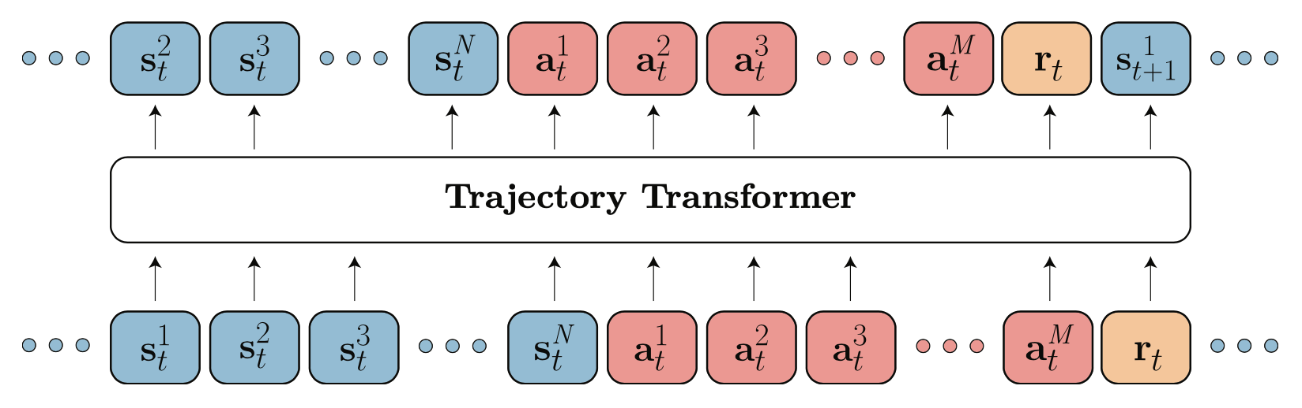
Generative Trajectory Modeling
transformer (sequence model) trained on fixed, limited experience consisting of trajectory rollouts of arbitrary policies (offline RL)
→ no need for bootstrapping
perform credit assignment directly via self-attention: implicitly forming state-return associations via similarity of query and key vectors (maximizing the dot product)
decoder architecture to autoregressively model trajectories
Trajectory Transformer: sequence model for joint distribution of states, actions, and rewards
Decision Transformer: conditional sequence model, conditioning on desired return (reward), past states, and actions to generate future actions
planning mirrors sampling procedure used to generate sequences from language model: selecting desired return tokens, acting as prompt for generation

Slide 31

Literature
papers:
…

Slide 32
Automation
...one of most impactful goals of AI
…computer vision, NLP
next step:
automated decision-making/control (e.g., autonomous driving)
…but also … nuclear fusion plasma stabilization
…control, robotics

